Slide 1
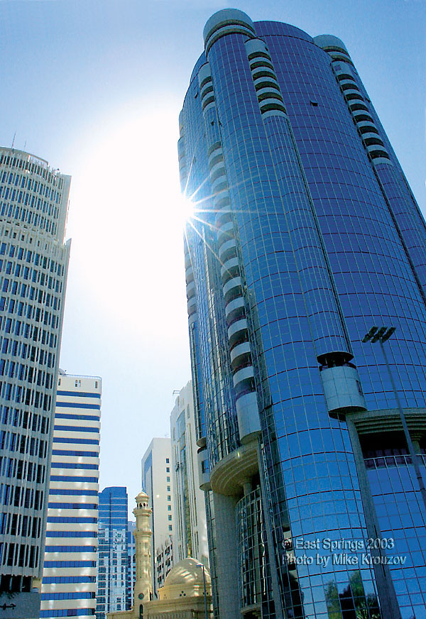
ENERGY AND ENVIRONMENT DIRECTORATE BUILDING ENERGY SYSTEMS & TECHNOLOGIES (BES&T)
INAUGURAL BUILDING SEMINAR SERIES
Presenter: MICHAEL HATTEN
Brief Biography:
Mike Hatten has been actively involved in analysis, design, and construction of energy efficient buildings since 1981. His credentials include professional engineer, analyst, educator, author, researcher, businessman, and student. His approach is multi-disciplinary and grounded in the real-world performance of buildings.
PRESENTATION:
USING INTEGRATED DESIGN TO ACHIEVE NET ZERO ENERGY PERFORMANCE
Integrated design involves a contextual set of design and analysis activities that deliver building energy efficiency potential at levels sufficient for buildings to ultimately achieve at net zero energy performance. Successful integrated design will navigate the relevant issues associated with site and climate, use and schedules, building loads, and mechanical/electrical systems. Climate and use have a priority role in this integrated path. Establishing energy performance and peak load goals are important activities that require energy and loads modeling throughout the integrated design process. This presentation illustrates these aspects of integrated design as they were applied to a new science museum project.
Contact information:
Jeanene Lee: jeanene.lee@pnnl.gov 375-2690
Sriram Somasundaram: sriram.somasundaram@pnnl.gov 375-6842
TUESDAY
OCTOBER 11, 2011
ETB/COLUMBIA RIVER ROOM
12 – 1 PM

